Slide 1
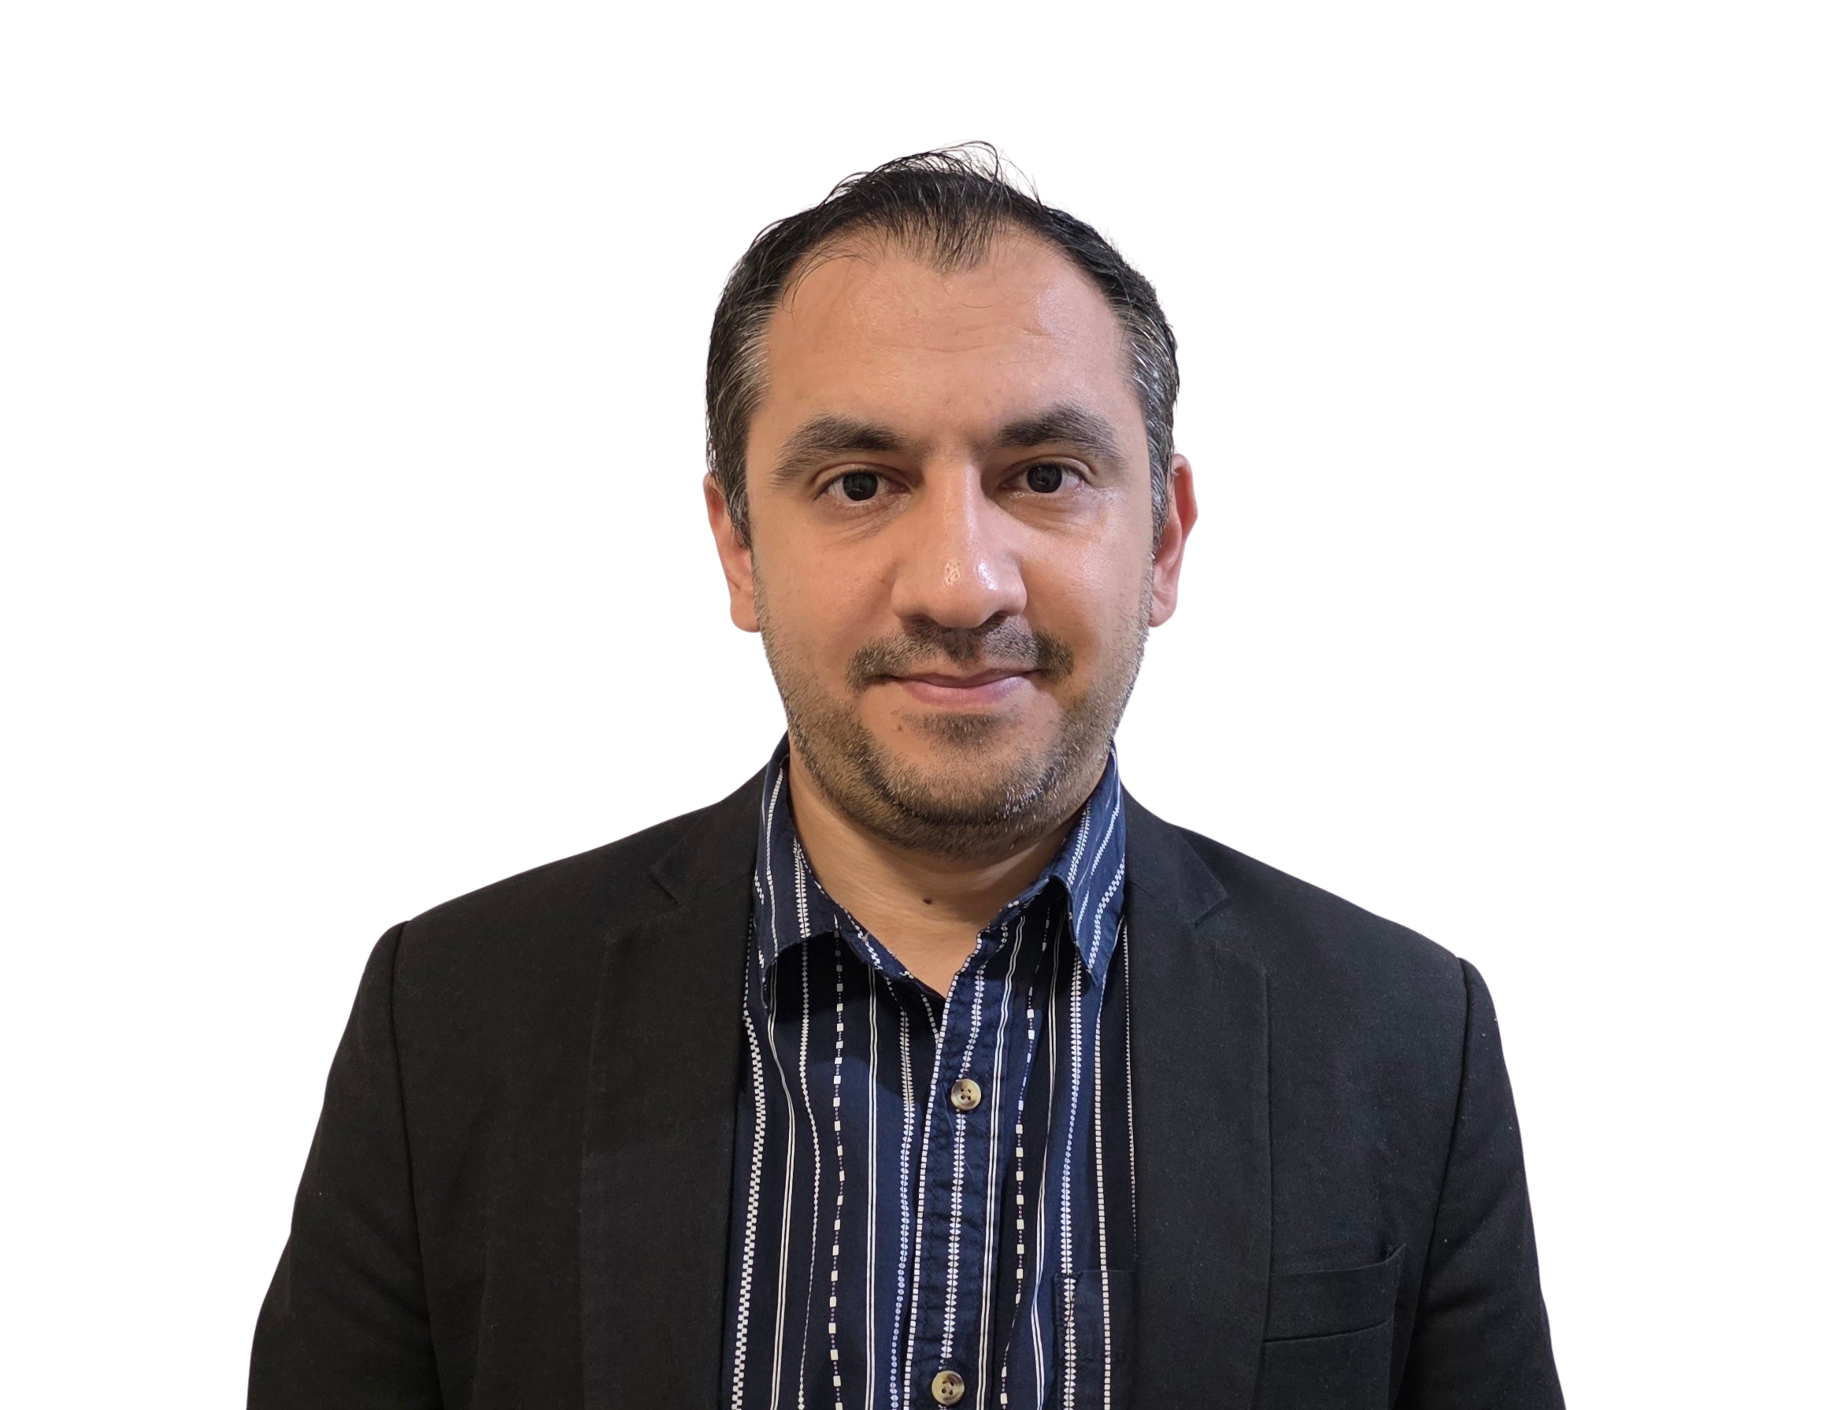
32555 – Fundamentals of Software Development

Slide 2
Welcome to 32555 – Fundamentals of Software Development
Your Teaching Team:
Dr. Yining Hu | Subject Coordinator
Yining is a Lecturer in Software Engineering. She works with many SMEs to develop software and AI solutions through student and research projects at UTS.
Contact: yining.hu@uts.edu.au
Dr. Xiaojie (Zoe) Lin | Tutor
Zoe is a full-stack software engineer with an interest in data analysis, specializing in JAVA, R, Python, JavaScript, PHP, Bash, and MATLAB; familiar with AWS.
Contact: Xiaojie.Lin@uts.edu.au
Dr. Farshid Keivanian | Tutor
Dr. Farshid Keivanian is an experienced university lecturer and researcher with a PhD in Information Technology. He has over 15 years of teaching experience across Australian institutions, specialising in software engineering, data science, AI, and cybersecurity.
Contact: Farshid.Keivanian@uts.edu.au
Yong Pov | Tutor
Yong is a full-stack software engineer with experience in React, JavaScript, TypeScript, Java, Python, SQL, and AI-assisted learning platforms.
Contact: Yong.Pov@uts.edu.au

Slide 3
Welcome to 32555 – Fundamentals of Software Development
Cmp1 # | Location | Time | Tutor
01 | CB11.B1.400 | Fri 16:00-18:00 | Xiaojie (Zoe) Lin
07 | CB11.B1.401 | Wed 10:00-12:00 | Farshid Keivanian
08 | CB11.B1.400 | Fri 12:00-14:00 | Yong Pov
09 | CB11.B1.103 | Wed 16:00-18:00 | Farshid Keivanian
10 | CB11.B1.401 | Wed 12:00-14:00 | Farshid Keivanian

Slide 4
Week 5 Outline
Have you formed your group?
Assessment Task 1: Case Study – Part 1: Analysis and Design Preparation Guide
Lab 5 Exercises
Class Diagram Practice
From UML Diagram to Code: Library Example (Java)
From UML Diagram to Code: Library Example (Python)
Activity 1 — Show the current count when limit blocks borrowing
Activity 2 — Show total borrowed after a successful borrow
Activity 3 — Show remaining count after a successful return
Activity 4 — Track how many times a book has ever been borrowed

Slide 5
Week 5 Outline
Activity 5 — Show who already has the book
Activity 6 — Show remaining slots after a successful borrow
Activity 7 — When returning a book you don’t have, show who actually has it
Activity 8 — Simple email sanity check on member creation
Activity 9 — Tidy book titles on creation
Activity 10 — Warn on duplicate ISBN when adding to the library
Reference Note for Students

Slide 6
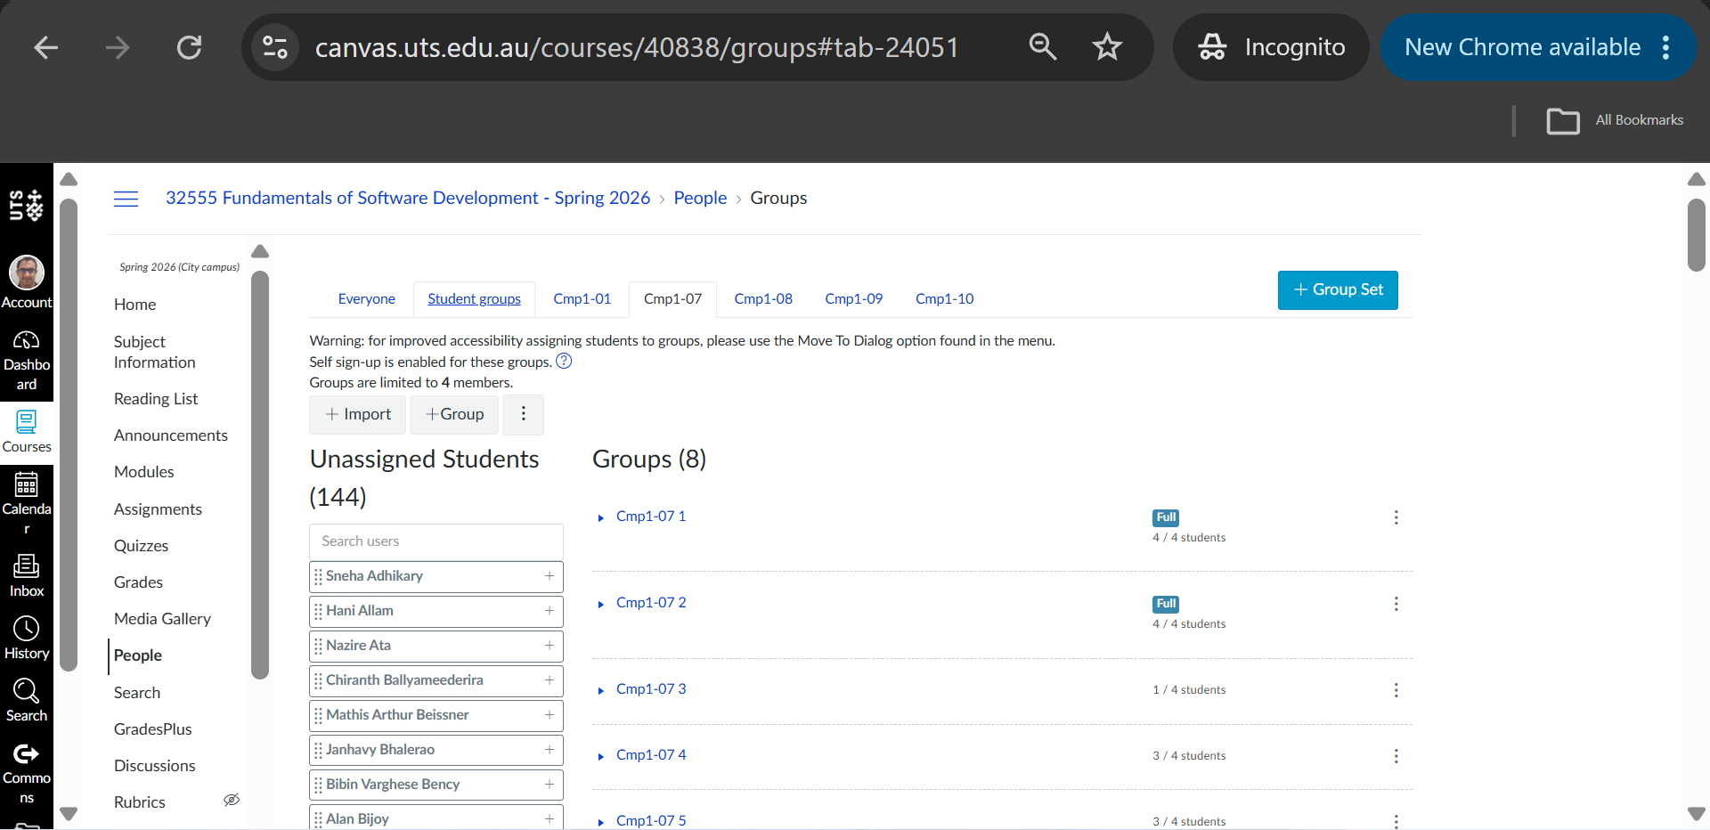
Have you formed your group?

Slide 7
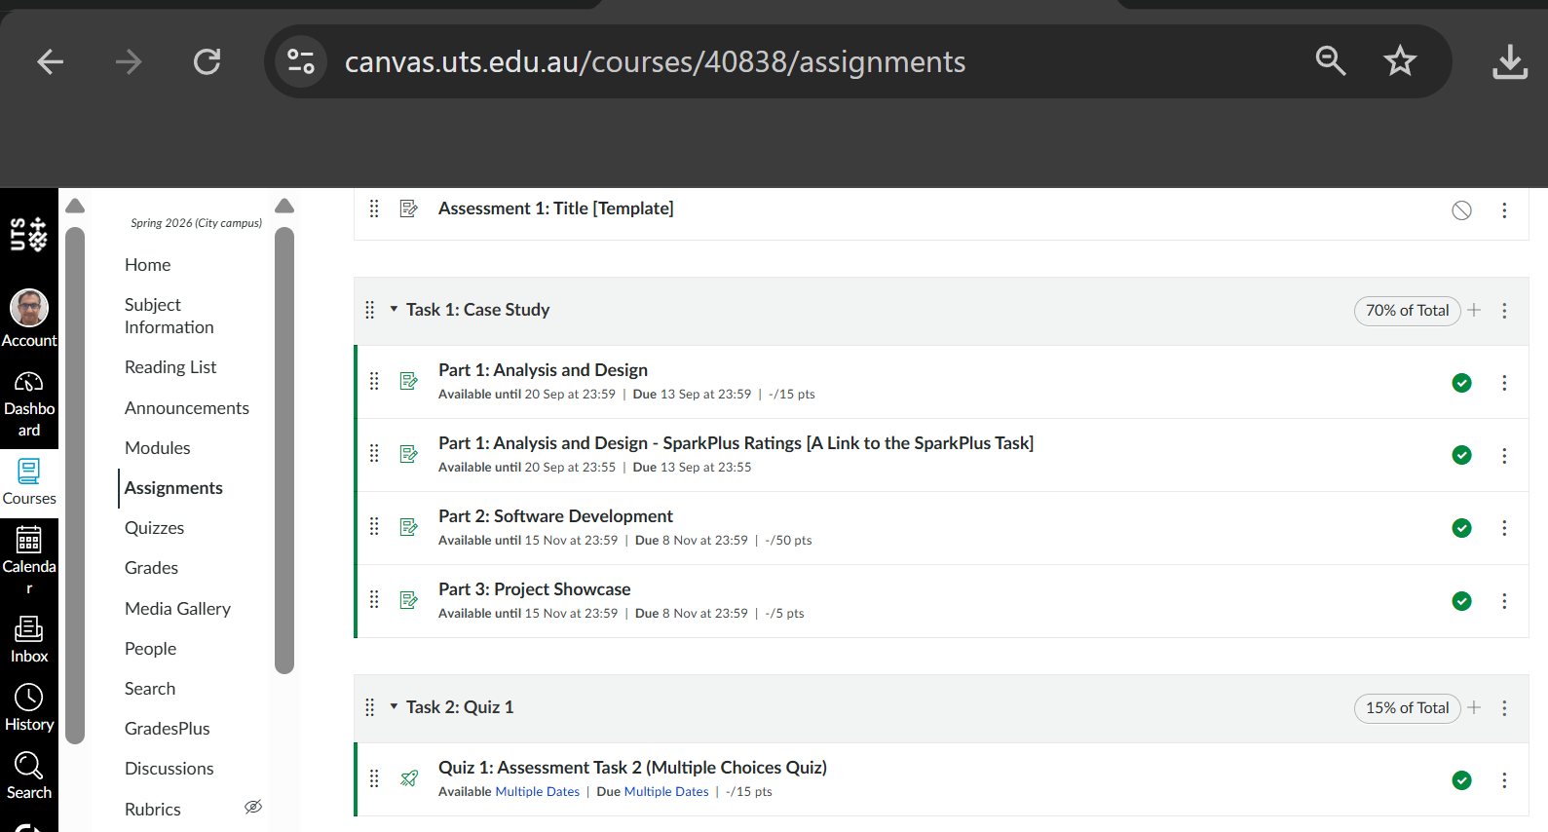
Assessment Task 1: Case Study – Part 1: Analysis and Design Preparation Guide

Slide 8
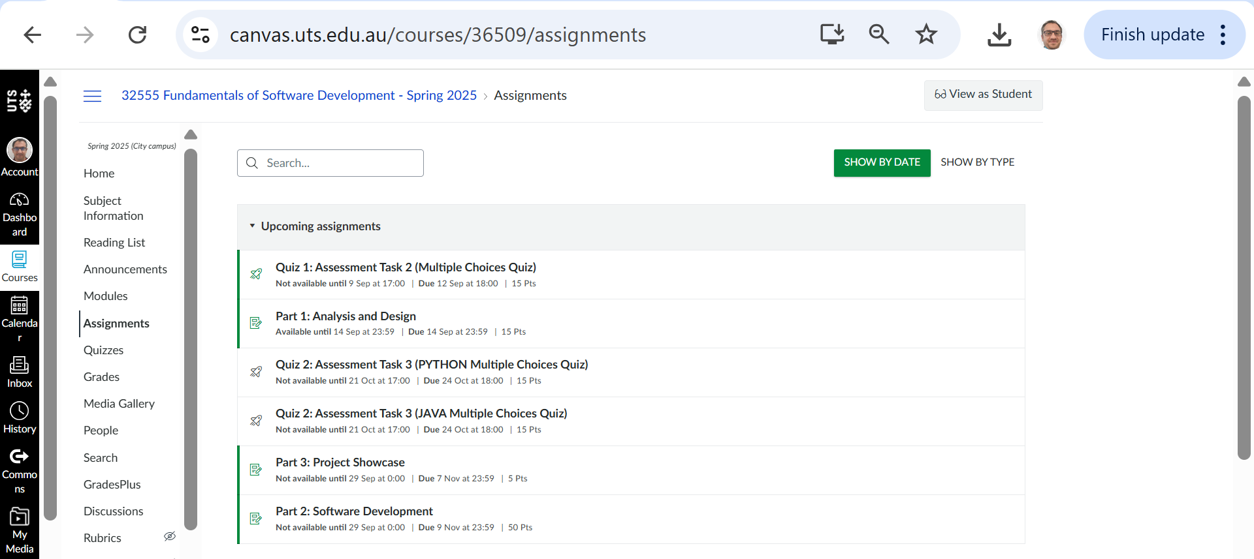
Assessment Task 1: Case Study – Part 1: Analysis and Design Preparation Guide

Slide 9
Assessment Task 1: Case Study – Part 1: Analysis and Design Preparation Guide
General admin (read first)
Groups: 3–4 students. Please finalise your group by the end of Week 4 using the Canvas group tool, or speak with your tutor during the lab if you need assistance.
Submission: One group file for Assessment 1 – Part 1 (PDF or DOCX) by Sunday, 13 September 2026, 11:59 pm (Week 7).

Slide 10
Assessment Task 1: Case Study – Part 1: Analysis and Design Preparation Guide
Filename: group-<group-number>-Cmp1<lab-number>.<pdf|docx> (e.g., group-07-Cmp103.pdf).
Peer rating (SparkPlus): Complete the SparkPlus peer-rating task by the deadline shown in Canvas. The current Part 1 SparkPlus task is due Sunday, 13 September 2026, 11:55 pm. Please check Canvas for its exact availability window.
Scope: Part 1 is analysis & design only (no code required). Part 2 is implementation; Part 3 is the showcase.

Slide 11
Assessment Task 1: Case Study – Part 1: Analysis and Design Preparation Guide
Step 1 – Define the scope
Actors: Student, Admin.
Students can: register, log in, enrol in up to 4 subjects, drop a subject, view enrolments, change password.
Admins can: view all students, group students by grade, categorize PASS/FAIL (mark < 50 = FAIL; mark ≥ 50 = PASS), remove a student, clear all data.

Slide 12
System must:
validate email (@university.com) and password pattern (Uppercase first, ≥ 5 letters, ≥ 3 digits),
generate 6-digit Student IDs (zero-padded) and 3-digit Subject IDs (zero-padded),
auto-assign a random mark between 25–100 and convert it to grade bands (Z/P/C/D/HD),
save/load all data from students.data.
Out of scope for Part 1 implementation: coding the GUI. GUIUniApp is a Part 2 challenge task. Part 1 focuses on requirements analysis and software design. Multi-semester enrolment is explicitly out of scope for the system.

Slide 13
Assessment Task 1: Case Study – Part 1: Analysis and Design Preparation Guide
Mini story Leila registers → system validates patterns, creates ID 000123. She enrols in 2 subjects → system creates codes 005 and 018 with marks 72 (C) and 89 (HD). Admin later categorises students into PASS/FAIL according to the required mark rule: mark < 50 → FAIL; mark ≥ 50 → PASS. In this simple example, Leila's two subject marks (72 and 89) are both PASS results.

Slide 14
Step 2 – Write user stories (3-digit IDs)
A user story may first be written in the form: “As a [user], I want to [do something] so that [result happens].” Then decompose/map the story into the required backlog columns: ID | User | Action | Result/Outcome | Function.
Group IDs by feature (hundreds digit):
1xx = Login
2xx = Register
3xx = Enrol
4xx = Drop
5xx = View
6xx = Change Password
7xx = Admin
8xx = File I/O
Each story = one action, one outcome (no “and then…”). Focus primarily on user goals and meaningful system behaviour. Internal implementation details do not automatically need their own user story.

Slide 15
Example backlog table:
Start from the system requirements and identify the main user actions. Give each item a unique 3-digit ID, identify the user/entity, describe one clear action, state the expected result, and provide the related action/function name in the Function column. Keep each row focused on one action and one outcome. Internal checks and validation rules can be documented separately as rules or constraints rather than always becoming separate backlog items.

Slide 16
Example backlog table:
Why is “System” used here?
Because the backlog defines User as the person or entity taking the action. If the application automatically performs an action, System can be appropriate. This does not mean System becomes an actor in the UML Use Case Diagram.

Slide 17
Example backlog table:
ID | User | Action | Result/Outcome | Function
100 | Student | Enter email + password | If match → Student menu; else error | login()
105 | System | Validate email/password | Show pattern error if invalid | validateCredentials()
200 | Student | Register account | New 6-digit ID created | registerStudent()
300 | Student | Enrol in subject | Subject (3-digit) added with grade | enrolSubject()
700 | Admin | View all students | List loaded from students.data | adminListAll()
For Example) 300 – Student – Enrol in subject – Subject added to the student's enrolments

Slide 18
Example backlog table:
The Function column identifies the related action/function. A meaningful function-style name such as login() or enrolSubject() is acceptable for illustrating the intended behaviour. The purpose in Part 1 is analysis and design, not implementing the code yet.

Slide 19
Assessment Task 1: Case Study – Part 1: Analysis and Design Preparation Guide
Step 3 – Draw a Use Case diagram
Actors: Student, Admin.
Use <<include>> when another use case is always required as part of a use case. For example, Register Student may include Validate Registration Details if validation is modelled as a reusable use case. Avoid turning every internal programming step into a separate use case.

Slide 20
Assessment Task 1: Case Study – Part 1: Analysis and Design Preparation Guide
Use <<extend>> for optional or conditional behaviour. For example, Show Authentication Error may extend Login when authentication fails. The <<extend>> arrow points from the extending use case toward the base use case.
Create one clear, comprehensive UML Use Case Diagram by identifying the actors, their goals, the relevant use cases, and the relationships between them. Keep the diagram focused on what users want the system to do rather than programming or interface details. Use <<include>> and <<extend>> only where they genuinely clarify a relationship between use cases.

Slide 21
Step 4 – Draw a UML Class Diagram
Use the requirements and use cases to identify the classes needed by the system.
Possible classes may include Student, Subject, and classes or services needed to support authentication and data storage. Your final class selection should be justified from the requirements rather than treated as a fixed list.

Slide 22
Step 4 – Draw a UML Class Diagram
Consider whether Admin needs to be represented as a class based on the data and behaviour it requires. If you include it, keep its role consistent with the requirements and the use-case model.
For each class, show:
appropriate attributes and data types
operations/methods, including parameters and return types where relevant
visibility symbols such as +, -, or #
meaningful relationships between classes
appropriate multiplicities, such as 1, 0..*, 1..*, or 0..4

Slide 23
Step 4 – Draw a UML Class Diagram
Example:
Student 1 ── 0..4 Subject
Use association, inheritance, aggregation, or composition only when the relationship is supported by your design. Do not add relationship types simply to demonstrate UML notation.
Your class diagram should represent the overall system and remain consistent with the requirements and use-case diagram.
Submit one clear, comprehensive UML Class Diagram for the system.

Slide 24
Step 5 – System rules
Email: must end with @university.com.
Password: regex → ^[A-Z][A-Za-z]{4,}\d{3,}$.
Student ID: 6-digit zero-padded (e.g., 000045).
Subject ID: unique auto-generated ID from 1 to 999. The brief describes this as a 3-digit subject ID. Keep your representation consistent with that requirement.
Grades:
< 50 → Z
50–64 → P
65–74 → C
75–84 → D
≥ 85 → HD

Slide 25
Optional design exercise – students.data The requirements state that registered student and enrolment data will be stored in students.data. You may show a possible structure for this file to help explain your class/data design. However, a separate data-file design is not one of the three explicitly assessed Part 1 components. The assessed components are the User Story Backlog, UML Use Case Diagram, and UML Class Diagram.

Slide 26
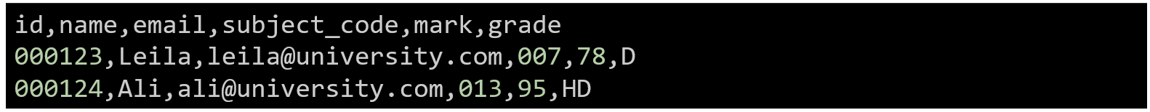
Step 6 – Optional Design Discussion – How Could students.data Be Structured?
JSON Lines example
{"id":"000123","name":"Leila","email":"leila@university.com","password":"Aabcd123","subjects":[{"code":"007","mark":78,"grade":"D"}]}
CSV alternative
These are examples only. The assessment brief requires the file students.data, but does not prescribe JSON or CSV format. Your chosen design should support the required student and enrolment information.

Slide 27
Assessment Task 1: Case Study – Part 1: Analysis and Design Preparation Guide
Step 7 – Quality check
Check traceability across your work: requirement → relevant user story/use case → supporting classes and operations. Not every item needs a one-to-one mapping, but nothing important from the requirements should disappear from the design.
Label multiplicities, include/extend.
Keep naming consistent (e.g., always “Enrol Subject”).

Slide 28
Assessment Task 1: Case Study – Part 1: Analysis and Design Preparation Guide
Recommended group planning – roles and responsibilities Your group may use a simple roles-and-responsibilities table to organise the work. All members are expected to contribute meaningfully to the complete submission and review the final work together. Individual contribution is also assessed through SparkPlus.
Member | Main Role | Also helps with…
Asha | User stories/backlog | Use Case diagram
Liam | Class diagram | Report formatting
Chen | Data file + rules | Proofreading

Slide 29
Assessment Task 1: Case Study – Part 1: Analysis and Design Preparation Guide
The table shows primary responsibilities only. All members are expected to contribute meaningfully to the overall group submission and review the final work together.
Member | Main Role | Also helps with…
Asha | User stories/backlog | Use Case diagram
Liam | Class diagram | Report formatting
Chen | Data file + rules | Proofreading
Primary roles help organise the work, but all group members should review and contribute to the complete submission.

Slide 30
Submission Checklist (1 file per group)
Cover page/group details
User Story Backlog
Use Case Diagram + explanations of actors, goals, use cases and relationships
UML Class Diagram + explanations of classes, fields, methods, visibility, relationships and multiplicities
Any supporting scope/rules information needed to make the analysis clear
Optional supporting material may include a proposed students.data format or a group contribution plan.
File name: group-<group-number>-Cmp1<lab-number>.<pdf|docx> Deadline: Sunday, Week 7.

Slide 31
Assessment Task 1: Case Study – Part 1: Analysis and Design Preparation Guide
Don’ts (common mistakes)
X Don’t mix multiple actions in one story. X Don’t use inconsistent IDs. X Don’t add UI/technical details (CLI/GUI ≠ actors). X Don’t forget multiplicities/labels. X Don’t design GUI (only Part 2). X Don’t submit multiple files (group submits one file).

Slide 32
Assessment Task 1: Case Study – Part 1: Analysis and Design Preparation Guide
Marking (15 marks)
Part 1 is worth 15 marks. Refer to the official Assessment 1 brief and rubric in Canvas for the marking criteria and allocation of marks.

Slide 33
Assessment Task 1: Case Study – Part 1: Analysis and Design Preparation Guide
Tools allowed
Backlog: Word/Excel table.
Diagrams: draw.io, Visio, PlantUML, Lucidchart, SmartDraw, even Word shapes.
No coding required in Part 1 (coding begins in Part 2).

Slide 34
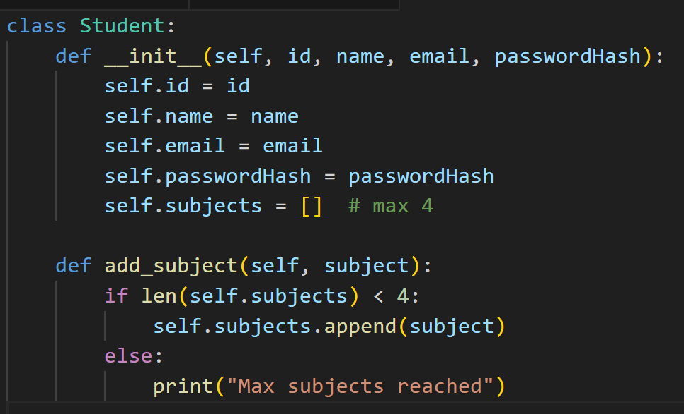
No coding is required for Part 1. The code below is for learning purposes only and should not be submitted as part of the Part 1 analysis and design deliverables. It simply illustrates how UML attributes and methods may later translate into code in Part 2.
See the example class structure above. You may use it only as a learning example to understand how UML attributes and methods could later correspond to implementation code in Part 2.

Slide 35
It shows what attributes (like id, name, email) and methods (like add_subject()) belong in each class.

Slide 36
This code is illustrative only. Names such as passwordHash represent possible implementation/design choices and are not prescribed by the Assessment 1 brief. You should justify your own class attributes and methods from the requirements.

Slide 37
Assessment Task 1: Case Study – Part 1: Analysis and Design Preparation Guide
For All Steps
Students can use drawing tools (draw.io, Lucidchart, Visio, or even Word’s SmartArt/shapes) for:
Step 2: Backlog → table in Word/Excel (not a diagram).
Step 3: Use case diagram → draw.io or PlantUML.
Step 4: Class diagram → draw.io, Visio, or PlantUML.
Students do not need to write code for diagrams. Coding only starts in Part 2.

Slide 38
Question and Answer (Canvas Inbox, Live, or Email)
Good morning,
Sir, I have a question for are we allowed to use other drawing app other than Visual diagrams?
Hope you have a great day!
Kind regards,

Slide 39
Answer:
Thank you for your question. For Assessment 1 – Part 1, you are not limited to one specific drawing tool. You may use draw.io (diagrams.net), Microsoft Visio, Lucidchart, or any other appropriate software to create your Use Case Diagram and Class Diagram, as long as the diagrams are clear, properly labelled, and consistent with the requirements.
Please remember that this part of the assessment focuses on analysis and design, so you are not required to write any code. What matters most is that the required analysis and design artefacts are clear, properly labelled, consistent with the case-study requirements, and meet the Assessment 1 brief and rubric.
You are free to choose whichever diagramming tool you are most comfortable with.
Kind regards, Dr. Farshid Keivanian

Slide 40
lab time: 120 minutes
Lab 5 has two objectives:
Primary: Implement the DeskBankApp [refer to Lab 4]
Secondary: Complete the practice exercises [ 1 to 5]
Complete the Lab 5 exercises using either Java or Python.
Recommended IDE for Java and Python: vscode

Slide 41
Case Study: Develop the DeskBankApp system – Third Implementation
This exercise is the third implementation of the DeskBankApp case study [refer to Lab4]
Sample I/O
1- The Bank class is the main system class
2- Use methods ( procedures and functions) to complete the following tasks:
- Write a function to read the starting balance from STDIN
- Write a deposit() procedure to make a deposit for a given amount
- Write a withdraw() procedure to make a withdraw of a given amount
- Write a show() procedure to show the current balance
- Incorporate deposit(), withdraw(), show() in a method called menu() with options:
(d) make a deposit
(w) make a withdraw
(s) show balance
(x) exit the system
The program repeatedly asks the user to enter an option until the user enters x to exit.
3- Update the main( ) method in Bank to use menu()
Start banking (d/w/s/x): s
Starting balance: $1000.00
Continue banking (d/w/s/x): d
Amount to deposit: $1000
Amount deposited: $1000.00
Continue banking (d/w/s/x): s
Starting balance: $2000.00
Continue banking (d/w/s/x): w
Amount to withdraw: $5000
Insufficient funds
Continue banking (d/w/s/x): w
Amount to withdraw: $500
Amount withdrawn: $500.00
Continue banking (d/w/s/x): s
Starting balance: $1500.00
Continue banking (d/w/s/x): x
Notes:
If you want to show 2 decimal places
scanner.next() reads only one word

Slide 42
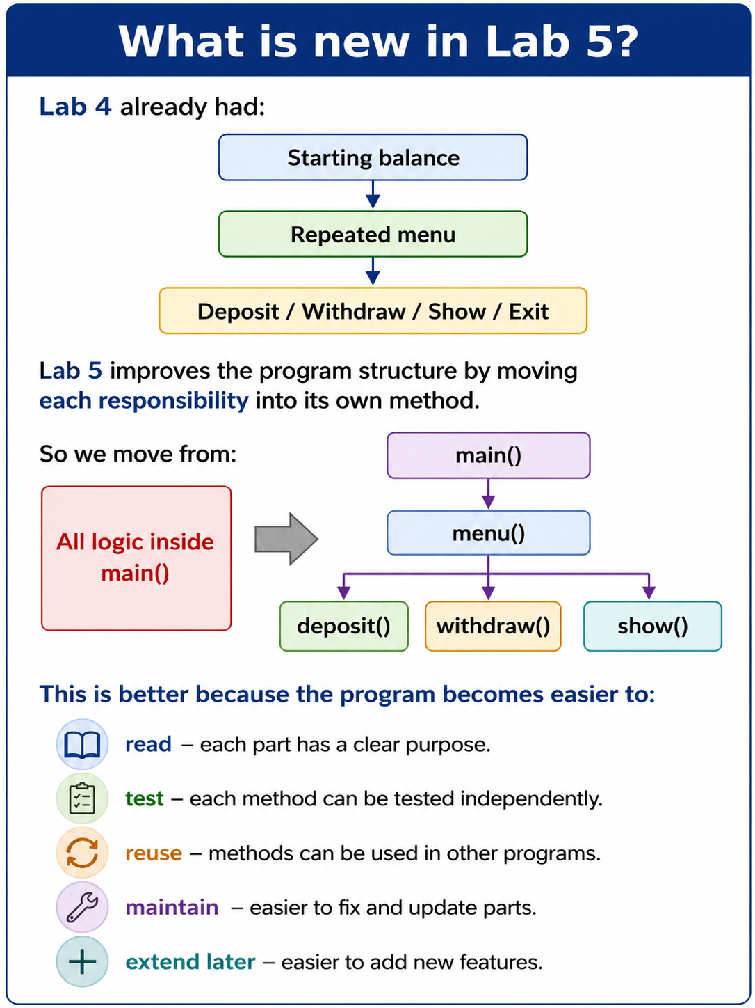
Case Study: Develop the DeskBankApp system – Third Implementation
Notes:
If you want to show 2 decimal places
scanner.next() reads only one word

Slide 43
Case Study: Develop the DeskBankApp system – Third Implementation
Step 1 — Create the Bank class
Python
Start with:
class Bank:
pass
This creates the Bank class.
Java
public class Bank {
}
This creates the Java Bank class.
Notes:
If you want to show 2 decimal places
scanner.next() reads only one word

Slide 44
Case Study: Develop the DeskBankApp system – Third Implementation
Step 2 — Add the balance field
We need a place to store the current balance.
Python
class Bank:
def __init__(self):
self.balance = 0.0
Explanation
self.balance
stores the current balance for this Bank object.
We start with 0.0 because the actual starting balance will be read from the keyboard.
Java
public class Bank {
private double balance;
}
Explanation
private double balance;
creates a decimal field called balance.
Notes:
If you want to show 2 decimal places
scanner.next() reads only one word

Slide 45
Step 3 — Write a function to read the starting balance
The task says:
Write a function to read the starting balance from STDIN.
STDIN means keyboard input in this lab.
Python
def read_starting_balance(self):
self.balance = float(input("Enter starting balance: $"))
Explanation
input(...) reads what the user types.
float(...) converts the input to a decimal number.
Notes:
If you want to show 2 decimal places
scanner.next() reads only one word

Slide 46
Java
We can create a method:
public void readStartingBalance(Scanner input) {
System.out.print("Enter starting balance: $");
balance = input.nextDouble();
input.nextLine();
}
Why do we use input.nextLine()?
After nextDouble(), Java leaves the Enter key in the input buffer.
nextLine() clears it so later menu input works correctly.
Notes:
If you want to show 2 decimal places
scanner.next() reads only one word

Slide 47
Step 4 — Write the deposit() procedure
A deposit should increase the balance.
Python
def deposit(self, amount):
self.balance += amount
Example
If:
balance = 1000
amount = 500
then:
new balance = 1500
Notes:
If you want to show 2 decimal places
scanner.next() reads only one word

Slide 48
Java
public void deposit(double amount) {
balance += amount;
}
Explanation
balance += amount;
is the same as:
balance = balance + amount;
Notes:
If you want to show 2 decimal places
scanner.next() reads only one word

Slide 49
Step 5 — Write the withdraw() procedure
A withdrawal should reduce the balance.
But we must check whether enough funds are available.
Python
def withdraw(self, amount):
if amount > self.balance:
raise ValueError("Insufficient funds")
self.balance -= amount
Explanation
If the withdrawal amount is bigger than the current balance:
raise ValueError(...)
creates an exception.
Otherwise:
self.balance -= amount
reduces the balance.
Notes:
If you want to show 2 decimal places
scanner.next() reads only one word

Slide 50
Java
public void withdraw(double amount) {
if (amount > balance) {
throw new IllegalArgumentException("Insufficient funds" );
}
balance -= amount;
}
Notes:
If you want to show 2 decimal places
scanner.next() reads only one word

Slide 51
Step 6 — Write the show() procedure
This method displays the current balance.
Python
def show(self):
print(f"Starting balance: ${self.balance:.2f}")
.2f means:
Display the amount using 2 decimal places.
Notes:
If you want to show 2 decimal places
scanner.next() reads only one word

Slide 52
Java
public void show() {
System.out.printf(
"Starting balance: $%.2f%n",
balance
);
}
Notes:
If you want to show 2 decimal places
scanner.next() reads only one word

Slide 53
Step 7 — Create the menu() method
The task says menu() should provide:
d → deposit
w → withdraw
s → show balance
x → exit
and repeat until x is entered.
Python — basic menu outline
Start with:
def menu(self):
while True:
choice = input("Continue banking (d/w/s/x): ").lower()
if choice == "x":
break
This creates the repeating structure first.
Notes:
If you want to show 2 decimal places
scanner.next() reads only one word

Slide 54
Java — basic menu outline
public void menu(Scanner input) {
while (true) {
System.out.print(
"Continue banking (d/w/s/x): "
);
String choice =
input.nextLine().toLowerCase();
if (choice.equals("x")) {
break;
}
}
}
Notes:
If you want to show 2 decimal places
scanner.next() reads only one word

Slide 55
Step 8 — Add deposit to menu()
Python
if choice == "d":
amount = float(input("Amount to deposit: $"))
self.deposit(amount)
print(f"Amount deposited: ${amount:.2f}")
Important point
Notice that menu() does not calculate the deposit itself.
It calls:
self.deposit(amount)
That is the purpose of methods: divide responsibilities.
Notes:
If you want to show 2 decimal places
scanner.next() reads only one word

Slide 56
Java
case "d":
System.out.print(
"Amount to deposit: $"
);
double depositAmount =
input.nextDouble();
input.nextLine();
deposit(depositAmount);
System.out.printf(
"Amount deposited: $%.2f%n",
depositAmount
);
break;
Notes:
If you want to show 2 decimal places
scanner.next() reads only one word

Slide 57
Step 9 — Add withdrawal to menu()
Python
elif choice == "w":
amount = float( input("Amount to withdraw: "))
try:
self.withdraw(amount)
print(f"Amount withdrawn: ${amount:.2f}")
except ValueError as error:
print(error)
Why try / except?
The method:
withdraw()
may raise:
ValueError
if there is not enough money.
try / except prevents the whole program from crashing.
Notes:
If you want to show 2 decimal places
scanner.next() reads only one word

Slide 58
Java
case "w":
System.out.print(
"Amount to withdraw: $"
);
double withdrawAmount =
input.nextDouble();
input.nextLine();
try {
withdraw(withdrawAmount);
System.out.printf(
"Amount withdrawn: $%.2f%n",
withdrawAmount
);
} catch (
IllegalArgumentException error
) {
System.out.println(
error.getMessage()
);
}
break;
Notes:
If you want to show 2 decimal places
scanner.next() reads only one word

Slide 59
Step 10 — Add show balance to menu()
Python
elif choice == "s":
self.show()
Java
case "s":
show();
break;
Notes:
If you want to show 2 decimal places
scanner.next() reads only one word

Slide 60
Step 11 — Handle invalid options
This is not explicitly stated, but it is good practice.
Python
else:
print("Invalid option")
Java
default:
System.out.println(
"Invalid option"
);
Notes:
If you want to show 2 decimal places
scanner.next() reads only one word

Slide 61
Step 12 — Use menu() from main()
The task specifically says:
Update the main() method in Bank to use menu().
Python
def main():
bank = Bank()
bank.read_starting_balance()
bank.menu()
Then:
if __name__ == "__main__":
main()
Java
public static void main(String[] args) {
Scanner input =
new Scanner(System.in);
Bank bank =
new Bank();
bank.readStartingBalance(input);
bank.menu(input);
input.close();
}
Notes:
If you want to show 2 decimal places
scanner.next() reads only one word

Slide 62
Step 13 — Completed Python solution
class Bank:
def __init__(self):
self.balance = 0.0
def read_starting_balance(self):
self.balance = float(
input(
"Enter starting balance: $"
)
)
def deposit(self, amount):
self.balance += amount
def withdraw(self, amount):
if amount > self.balance:
raise ValueError(
"Insufficient funds"
)
self.balance -= amount
def show(self):
print(
f"Starting balance: "
f"${self.balance:.2f}"
)
def menu(self):
first_time = True
while True:
if first_time:
choice = input(
"Start banking "
"(d/w/s/x): "
).lower()
first_time = False
else:
choice = input(
"Continue banking "
"(d/w/s/x): "
).lower()
Notes:
If you want to show 2 decimal places
scanner.next() reads only one word

Slide 63
if choice == "d":
amount = float(
input(
"Amount to deposit: $"
)
)
self.deposit(amount)
print(
f"Amount deposited: "
f"${amount:.2f}"
)
elif choice == "w":
amount = float(
input(
"Amount to withdraw: $"
)
)
try:
self.withdraw(amount)
print(
f"Amount withdrawn: "
f"${amount:.2f}"
)
except ValueError as error:
print(error)
elif choice == "s":
self.show()
elif choice == "x":
break
else:
print("Invalid option")
def main():
bank = Bank()
bank.read_starting_balance()
bank.menu()
if __name__ == "__main__":
main()
Notes:
If you want to show 2 decimal places
scanner.next() reads only one word

Slide 64
Step 14 — Completed Java solution
import java.util.Scanner;
public class Bank {
private double balance;
public void readStartingBalance(
Scanner input
) {
System.out.print(
"Enter starting balance: $"
);
balance =
input.nextDouble();
input.nextLine();
}
public void deposit(
double amount
) {
balance += amount;
}
public void withdraw(
double amount
) {
if (amount > balance) {
throw new IllegalArgumentException(
"Insufficient funds"
);
}
balance -= amount;
}
Notes:
If you want to show 2 decimal places
scanner.next() reads only one word

Slide 65
public void show() {
System.out.printf(
"Starting balance: $%.2f%n",
balance
);
}
public void menu(
Scanner input
) {
boolean firstTime = true;
while (true) {
if (firstTime) {
System.out.print(
"Start banking "
+ "(d/w/s/x): "
);
firstTime = false;
} else {
System.out.print(
"Continue banking "
+ "(d/w/s/x): "
);
}
String choice =
input.nextLine()
.toLowerCase();
switch (choice) {
Notes:
If you want to show 2 decimal places
scanner.next() reads only one word

Slide 66
case "d":
System.out.print(
"Amount to deposit: $"
);
double depositAmount =
input.nextDouble();
input.nextLine();
deposit(
depositAmount
);
System.out.printf(
"Amount deposited: "
+ "$%.2f%n",
depositAmount
);
break;
case "w":
System.out.print(
"Amount to withdraw: $"
);
double withdrawAmount =
input.nextDouble();
input.nextLine();
try {
withdraw(
withdrawAmount
);
System.out.printf(
"Amount withdrawn: "
+ "$%.2f%n",
withdrawAmount
);
Notes:
If you want to show 2 decimal places
scanner.next() reads only one word

Slide 67
} catch (
IllegalArgumentException
error
) {
System.out.println(
error.getMessage()
);
}
break;
case "s":
show();
break;
case "x":
return;
default:
System.out.println(
"Invalid option"
);
}
}
}
public static void main(
String[] args
) {
Scanner input =
new Scanner(System.in);
Bank bank =
new Bank();
bank.readStartingBalance(
input
);
bank.menu(
input
);
input.close();
}
}
Notes:
If you want to show 2 decimal places
scanner.next() reads only one word

Slide 68
Step 15 — Explain procedures vs functions simply
The lab mentions: methods (procedures and functions)
What this means.
Procedure
A procedure performs an action but normally does not return a result.
Examples:
deposit()
withdraw()
show()
menu()
Notes:
If you want to show 2 decimal places
scanner.next() reads only one word

Slide 69
In Java, these commonly have:
void
as the return type.
Function
A function returns a value.
For example, a different design could use:
def get_balance(self):
return self.balance
or Java:
public double getBalance() {
return balance;
}
In this Lab 5 design, readStartingBalance() could technically return the value instead of directly changing balance, but the supplied task mainly focuses on method decomposition rather than strict terminology.
Notes:
If you want to show 2 decimal places
scanner.next() reads only one word

Slide 70
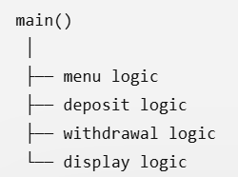
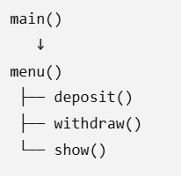
Step 16 — Connect Lab 4 to Lab 5
Lab 4
Lab 5
Everything may be mixed together.
This design is more modular.
Why is it better? If we later change how withdrawals work, we can update: withdraw() without rewriting the entire menu.
Notes:
If you want to show 2 decimal places
scanner.next() reads only one word

Slide 71
Step 17 — Q&A
Q1. Why create separate methods instead of writing everything in main()?
Because separate methods make the program easier to understand, test, reuse, and maintain.
Q2. What does menu() do?
It controls the user's choices and calls the appropriate banking method.
Q3. Does menu() itself calculate the new balance?
No. It calls deposit() or withdraw().
Notes:
If you want to show 2 decimal places
scanner.next() reads only one word

Slide 72
Step 17 — Q&A
Q4. Why does withdraw() need exception handling?
Because a customer should not be able to withdraw more than the available balance.
Q5. Why does the program use a loop?
Because it must repeatedly show banking choices until the user chooses x.
Q6. What does x do?
It exits the menu and ends the program.
Q7. What is the main improvement from Lab 4 to Lab 5?
The banking logic is divided into separate methods rather than being written as one large block.
Notes:
If you want to show 2 decimal places
scanner.next() reads only one word

Slide 73
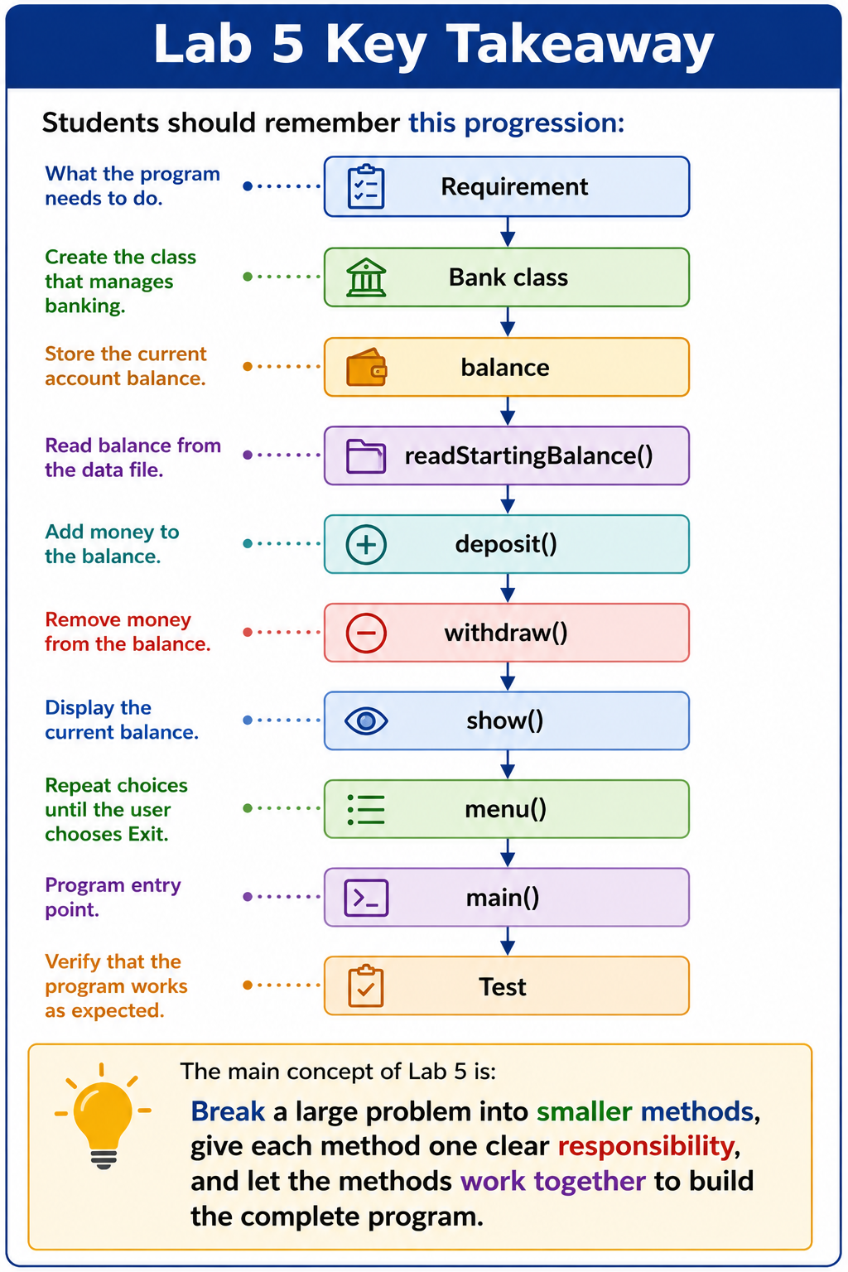
Key Takeaway of Case Study: Develop the DeskBankApp system – Third Implementation
Notes:
If you want to show 2 decimal places
scanner.next() reads only one word

Slide 74
Exercise 1 — Circle and Sphere Calculations Using Methods
Develop a program called Lab5Exc1 that uses methods to complete the following operations:
Read a radius (decimal number) from STDIN
Calculate the perimeter of a circle using the radius
Calculate the area of a disk using the radius
Calculate the sphere volume using the radius
Show calculated values on separate lines (show 3 decimal places)
Sample I/O
Radius = 2.5
Perimeter = 15.708
Area = 19.635
Volume = 65.450

Slide 75
What are we building?
Create Lab5Exc1 with separate methods to:
Read a decimal radius.
Calculate circle perimeter.
Calculate disk area.
Calculate sphere volume.
Display each answer to 3 decimal places.
The formulas are: Perimeter=2πr, Area=πr^2 Volume=4​/3πr^3
For r = 2.5: Radius = 2.5, Perimeter = 15.708, Area = 19.635, Volume = 65.450

Slide 76
Exercise 1 — Circle and Sphere Calculations Using Methods
Python
Step 1 — Start with the program structure
import math
def main():
pass
if __name__ == "__main__":
main()
We import math because we need math.pi.

Slide 77
Step 2 — Write a function to read the radius
def read_radius():
return float(input("Radius = "))
This is a function because it returns a value.

Slide 78
Step 3 — Write the perimeter function
def calculate_perimeter(radius):
return 2 * math.pi * radius

Slide 79
Step 4 — Write the area function
def calculate_area(radius):
return math.pi * radius ** 2
** means raised to the power 2
** 2 means squar e.

Slide 80
Step 5 — Write the volume function
def calculate_volume(radius):
return (4 / 3) * math.pi * radius ** 3

Slide 81
Step 6 — Write a procedure to display the results
def show_results(perimeter, area, volume):
print(f"Perimeter = {perimeter:.3f}")
print(f"Area = {area:.3f}")
print(f"Volume = {volume:.3f}")
.3f means exactly 3 decimal places.

Slide 82
Step 7 — Connect everything in main()
def main():
radius = read_radius()
perimeter = calculate_perimeter(radius)
area = calculate_area(radius)
volume = calculate_volume(radius)
show_results(perimeter, area, volume)

Slide 83
Completed Python — Lab5Exc1.py
import math
def read_radius():
return float(input("Radius = "))
def calculate_perimeter(radius):
return 2 * math.pi * radius
def calculate_area(radius):
return math.pi * radius ** 2
def calculate_volume(radius):
return (4 / 3) * math.pi * radius ** 3
def show_results(perimeter, area, volume):
print(f"Perimeter = {perimeter:.3f}")
print(f"Area = {area:.3f}")
print(f"Volume = {volume:.3f}")
def main():
radius = read_radius()
perimeter = calculate_perimeter(radius)
area = calculate_area(radius)
volume = calculate_volume(radius)
show_results(perimeter, area, volume)
if __name__ == "__main__":
main()

Slide 84
Java
Step 1 — Basic structure
public class Lab5Exc1 {
public static void main(String[] args) {
}
}

Slide 85
Step 2 — Read the radius
public static double readRadius(Scanner input) {
System.out.print("Radius = ");
return input.nextDouble();
}

Slide 86
Step 3 — Calculate perimeter
public static double calculatePerimeter(double radius) {
return 2 * Math.PI * radius;
}

Slide 87
Step 4 — Calculate area
public static double calculateArea(double radius) {
return Math.PI * Math.pow(radius, 2);
}

Slide 88
Step 5 — Calculate volume
public static double calculateVolume(double radius) {
return (4.0 / 3.0)
* Math.PI
* Math.pow(radius, 3);
}

Slide 89
Step 6 — Display results
public static void showResults(
double perimeter,
double area,
double volume) {
System.out.printf(
"Perimeter = %.3f%n",
perimeter
);
System.out.printf(
"Area = %.3f%n",
area
);
System.out.printf(
"Volume = %.3f%n",
volume
);
}

Slide 90
Completed Java — Lab5Exc1.java
import java.util.Scanner;
public class Lab5Exc1 {
public static double readRadius(Scanner input) {
System.out.print("Radius = ");
return input.nextDouble();
}
public static double calculatePerimeter(
double radius) {
return 2 * Math.PI * radius;
}
public static double calculateArea(
double radius) {
return Math.PI * Math.pow(radius, 2);
}
public static double calculateVolume(
double radius) {
return (4.0 / 3.0)
* Math.PI
* Math.pow(radius, 3);
}
public static void showResults(
double perimeter,
double area,
double volume) {
System.out.printf(
"Perimeter = %.3f%n",
perimeter
);
System.out.printf(
"Area = %.3f%n",
area
);

Slide 91
System.out.printf(
"Volume = %.3f%n",
volume
);
}
public static void main(String[] args) {
Scanner input = new Scanner(System.in);
double radius = readRadius(input);
double perimeter =
calculatePerimeter(radius);
double area =
calculateArea(radius);
double volume =
calculateVolume(radius);
showResults(
perimeter,
area,
volume
);
input.close();
}
}

Slide 92
Exercise 2 — Random Numbers, Mean and Standard Deviation:
Develop a program called Lab5Exc2 that includes the following methods:
Define a function to generate 20 random numbers [ 0 <= number <= 100 ] and return the values in an array
Define a function that takes an array as parameter and calculates the mean
Define a function that takes an array as parameter and calculates the standard deviation
Define a procedure that shows the mean and standard deviation of the array in step 1 (show 2 decimal places)

Slide 93
Exercise 2 — Random Numbers, Mean and Standard Deviation:
What are we building?
The program should:
Generate 20 random integers between 0 and 100, inclusive.
Return them in an array/list.
Calculate the mean.
Calculate the standard deviation.
Display mean and standard deviation to 2 decimal places.

Slide 94
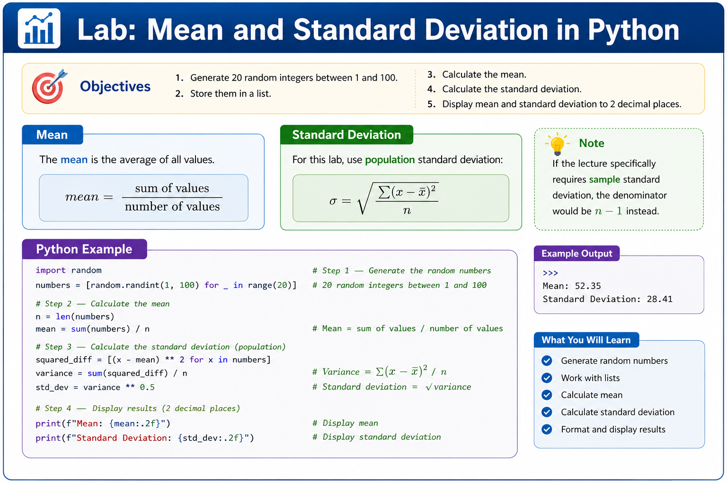
Exercise 2 — Random Numbers, Mean and Standard Deviation:

Slide 95
Python
Step 1 — Generate the random numbers
import random
def generate_numbers():
numbers = []
for i in range(20):
number = random.randint(0, 100)
numbers.append(number)
return numbers
randint(0, 100) includes both 0 and 100.

Slide 96
Step 2 — Calculate the mean
def calculate_mean(numbers):
total = sum(numbers)
return total / len(numbers)

Slide 97
Step 3 — Start the standard deviation
First calculate the mean:
mean = calculate_mean(numbers)
Then calculate how far each number is from the mean.
difference = number - mean
Square the difference:
difference ** 2

Slide 98
Step 4 — Complete the standard deviation function
def calculate_standard_deviation(numbers):
mean = calculate_mean(numbers)
total_squared_difference = 0
for number in numbers:
difference = number - mean
total_squared_difference += (
difference ** 2
)
variance = (
total_squared_difference
/ len(numbers)
)
return variance ** 0.5
** 0.5 calculates the square root.

Slide 99
Step 5 — Display the results
def show_results(numbers):
mean = calculate_mean(numbers)
standard_deviation = (calculate_standard_deviation(numbers))
print("Numbers:", numbers)
print(f"Mean = {mean:.2f}")
print(
f"Standard deviation = "
f"{standard_deviation:.2f}"
)

Slide 100
Completed Python — Lab5Exc2.py
import random
def generate_numbers():
numbers = []
for i in range(20):
number = random.randint(0, 100)
numbers.append(number)
return numbers
def calculate_mean(numbers):
total = sum(numbers)
return total / len(numbers)
def calculate_standard_deviation(numbers):
mean = calculate_mean(numbers)
total_squared_difference = 0
for number in numbers:
difference = number - mean
total_squared_difference += (
difference ** 2
)
variance = (
total_squared_difference
/ len(numbers)
)
return variance ** 0.5
def show_results(numbers):
mean = calculate_mean(numbers)
standard_deviation = (
calculate_standard_deviation(numbers)
)

Slide 101
print("Numbers:", numbers)
print(
f"Mean = {mean:.2f}"
)
print(
f"Standard deviation = "
f"{standard_deviation:.2f}"
)
def main():
numbers = generate_numbers()
show_results(numbers)
if __name__ == "__main__":
main()

Slide 102
Java
Step 1 — Generate 20 numbers
public static int[] generateNumbers() {
Random random = new Random();
int[] numbers = new int[20];
for (int i = 0; i < numbers.length; i++) {
numbers[i] =
random.nextInt(101);
}
return numbers;
}
Why 101? random.nextInt(101)
produces: 0 through 100

Slide 103
Step 2 — Calculate mean
public static double calculateMean(
int[] numbers) {
int total = 0;
for (int number : numbers) {
total += number;
}
return (double) total
/ numbers.length;
}

Slide 104
Step 3 — Calculate standard deviation
public static double calculateStandardDeviation(
int[] numbers) {
double mean =
calculateMean(numbers);
double totalSquaredDifference = 0;
for (int number : numbers) {
double difference =
number - mean;
totalSquaredDifference +=
difference * difference;
}
double variance =
totalSquaredDifference
/ numbers.length;
return Math.sqrt(variance);
}

Slide 105
Step 4 — Show the results
public static void showResults(
int[] numbers) {
System.out.println(
Arrays.toString(numbers)
);
System.out.printf(
"Mean = %.2f%n",
calculateMean(numbers)
);
System.out.printf(
"Standard deviation = %.2f%n",
calculateStandardDeviation(numbers)
);
}

Slide 106
Completed Java — Lab5Exc2.java
import java.util.Arrays;
import java.util.Random;
public class Lab5Exc2 {
public static int[] generateNumbers() {
Random random = new Random();
int[] numbers = new int[20];
for (
int i = 0;
i < numbers.length;
i++
) {
numbers[i] =
random.nextInt(101);
}
return numbers;
}
public static double calculateMean(
int[] numbers) {
int total = 0;
for (int number : numbers) {
total += number;
}
return (double) total
/ numbers.length;
}

Slide 107
public static double calculateStandardDeviation(
int[] numbers) {
double mean =
calculateMean(numbers);
double totalSquaredDifference = 0;
for (int number : numbers) {
double difference =
number - mean;
totalSquaredDifference +=
difference * difference;
}
double variance =
totalSquaredDifference
/ numbers.length;
return Math.sqrt(variance);
}
public static void showResults(
int[] numbers) {
System.out.println(
"Numbers = "
+ Arrays.toString(numbers)
);
System.out.printf(
"Mean = %.2f%n",
calculateMean(numbers)
);
System.out.printf(
"Standard deviation = %.2f%n",
calculateStandardDeviation(numbers)
);
}
public static void main(String[] args) {
int[] numbers =
generateNumbers();
showResults(numbers);
}
}

Slide 108
Exercise 3 — Count Vowels Using Methods
Exercise 3:
Develop a program called Lab5Exc3 that includes the following methods:
Define a function to read a sentence from keyboard
Define a function to count the number of vowels in the sentence
Define a procedure to show the number of vowels in the sentence
NOTE:
The program stops when * is entered from keyboard
Sample I/O
String: welcome to THE WORLD
Vowel count = 6
String: *
Done

Slide 109
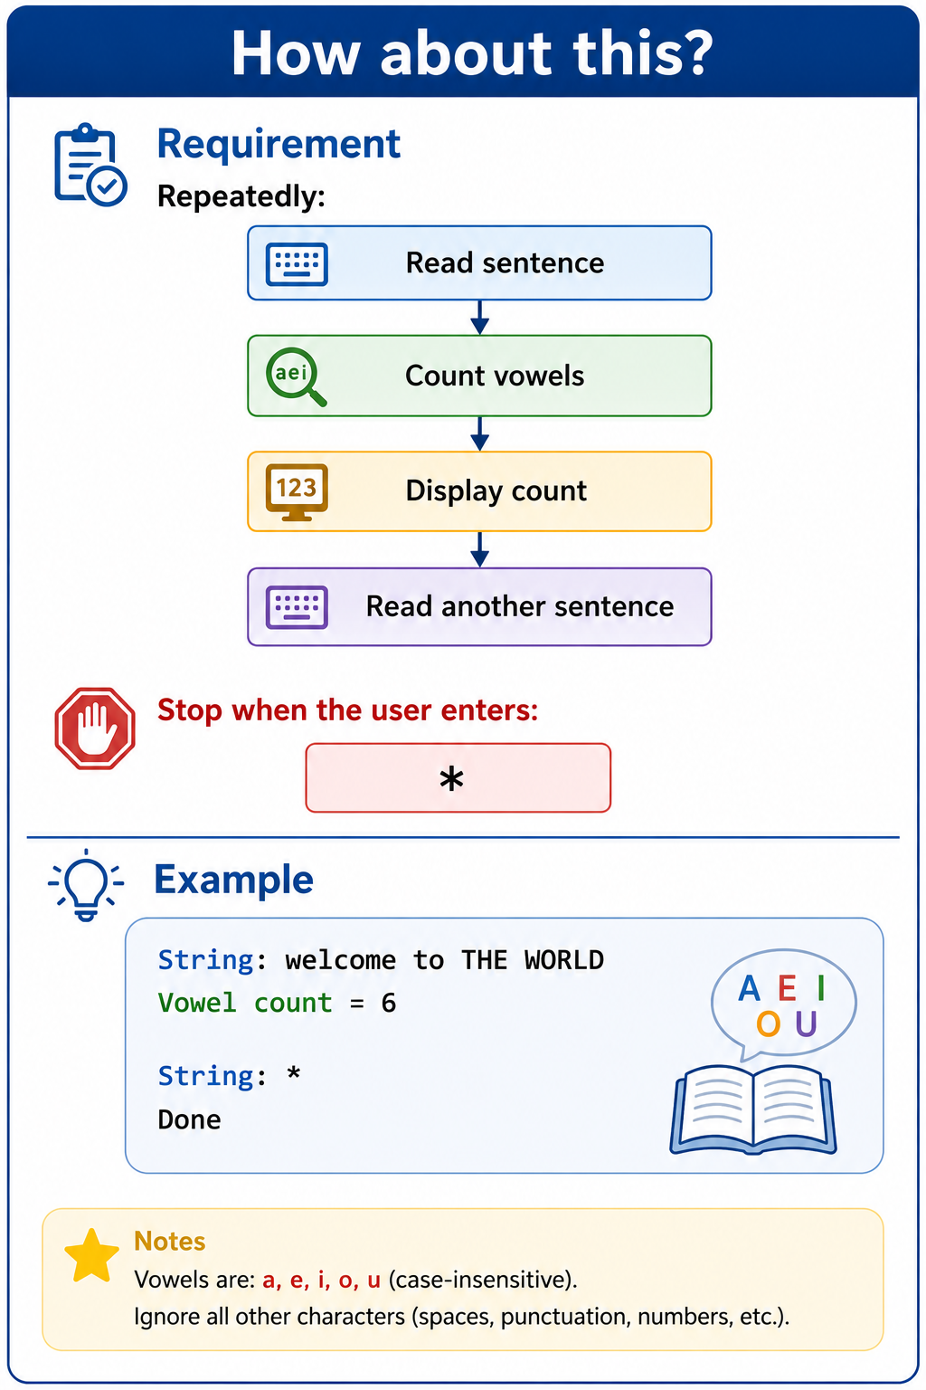
Exercise 3 — Count Vowels Using Methods

Slide 110
Exercise 3 — Count Vowels Using Methods
Python
Step 1 — Read a sentence
def read_sentence():
return input("String: ")

Slide 111
Exercise 3 — Count Vowels Using Methods
Step 2 — Count vowels
def count_vowels(sentence):
count = 0
for character in sentence:
if character.lower() in "aeiou":
count += 1
return count
lower() means uppercase vowels are also counted.

Slide 112
Exercise 3 — Count Vowels Using Methods
Step 3 — Show the result
def show_vowel_count(count):
print(f"Vowel count = {count}")

Slide 113
Exercise 3 — Count Vowels Using Methods
Step 4 — Add the repeated loop
while True:
sentence = read_sentence()
if sentence == "*":
print("Done")
break

Slide 114
Completed Python — Lab5Exc3.py
def read_sentence():
return input("String: ")
def count_vowels(sentence):
count = 0
for character in sentence:
if character.lower() in "aeiou":
count += 1
return count
def show_vowel_count(count):
print(
f"Vowel count = {count}"
)
def main():
while True:
sentence = read_sentence()
if sentence == "*":
print("Done")
break
count = count_vowels(sentence)
show_vowel_count(count)
if __name__ == "__main__":
main()

Slide 115
Java
Step 1 — Read sentence
public static String readSentence(
Scanner input) {
System.out.print("String: ");
return input.nextLine();
}

Slide 116
Step 2 — Count vowels
public static int countVowels(
String sentence) {
int count = 0;
sentence =
sentence.toLowerCase();
for (
int i = 0;
i < sentence.length();
i++
) {
char ch =
sentence.charAt(i);
if (
ch == 'a'
|| ch == 'e'
|| ch == 'i'
|| ch == 'o'
|| ch == 'u'
) {
count++;
}
}
return count;
}

Slide 117
Step 3 — Show count
public static void showVowelCount(
int count) {
System.out.println(
"Vowel count = " + count
);
}

Slide 118
Completed Java — Lab5Exc3.java
import java.util.Scanner;
public class Lab5Exc3 {
public static String readSentence(
Scanner input) {
System.out.print("String: ");
return input.nextLine();
}
public static int countVowels(
String sentence) {
int count = 0;
sentence =
sentence.toLowerCase();
for (
int i = 0;
i < sentence.length();
i++
) {
char ch =
sentence.charAt(i);
if (
ch == 'a'
|| ch == 'e'
|| ch == 'i'
|| ch == 'o'
|| ch == 'u'
) {
count++;
}
}
return count;
}

Slide 119
public static void showVowelCount(
int count) {
System.out.println(
"Vowel count = " + count
);
}
public static void main(String[] args) {
Scanner input = new Scanner(System.in);
while (true) {
String sentence =
readSentence(input);
if (sentence.equals("*")) {
System.out.println("Done");
break;
}
int count =
countVowels(sentence);
showVowelCount(count);
}
input.close();
}
}

Slide 120
Exercise 4 — Factorial Methods and Arrays
Develop a program called Lab5Ex4 to achieve the following:
Define a function to generate 5 random numbers [ 0 <= number <= 10 ] and return the values in an array
Define a function called ‘factorial’ that takes a number as parameter and calculate the factorial of that number
Define a function called ‘factorial’ that takes an array of numbers as parameter and calculate the factorial of each value in the array then store the calculated factorials into a new array and return it
Define a procedure that shows the array of randoms/factorials

Slide 121
Exercise 4 — Factorial Methods and Arrays
This exercise is especially useful because it demonstrates method overloading in Java.
We need:
Generate five random integers from 0 to 10.
Calculate the factorial of one number.
Calculate the factorial of every number in an array.
Return the factorial array.
Display both arrays.

Slide 122
Exercise 4 — Factorial Methods and Arrays
What is factorial?
5! = 5 × 4 × 3 × 2 × 1
= 120
Also:
0! = 1

Slide 123
Exercise 4 — Factorial Methods and Arrays
Step 1 — Generate five random numbers
def generate_numbers():
numbers = []
for i in range(5):
numbers.append(
random.randint(0, 10)
)
return numbers

Slide 124
Exercise 4 — Factorial Methods and Arrays
Step 2 — Factorial of one number
def factorial(number):
result = 1
for i in range(1, number + 1):
result *= i
return result

Slide 125
Exercise 4 — Factorial Methods and Arrays
Step 3 — Factorial of the array
def factorial_array(numbers):
results = []
for number in numbers:
results.append(
factorial(number)
)
return results
Notice that we reuse:
factorial(number)
instead of rewriting the factorial calculation.

Slide 126
Exercise 4 — Factorial Methods and Arrays
Step 4 — Show arrays
def show_arrays(
numbers,
factorials):
print("Random numbers:", numbers)
print("Factorials:", factorials)

Slide 127
Completed Python — Lab5Ex4.py
import random
def generate_numbers():
numbers = []
for i in range(5):
numbers.append(
random.randint(0, 10)
)
return numbers
def factorial(number):
result = 1
for i in range(1, number + 1):
result *= i
return result
def factorial_array(numbers):
results = []
for number in numbers:
results.append(
factorial(number)
)
return results
def show_arrays(
numbers,
factorials):
print(
"Random numbers:",
numbers
)
print(
"Factorials:",
factorials
)

Slide 128
def main():
numbers =
generate_numbers()
factorials =
factorial_array(numbers)
show_arrays(
numbers,
factorials
)
if __name__ == "__main__":
main()

Slide 129
Java
Java supports method overloading.
This means we can write: factorial(int number)
and: factorial(int[] numbers)
They have the same name but different parameters.

Slide 130
Step 1 — Generate five random numbers
public static int[] generateNumbers() {
Random random = new Random();
int[] numbers = new int[5];
for (
int i = 0;
i < numbers.length;
i++
) {
numbers[i] =
random.nextInt(11);
}
return numbers;
}

Slide 131
Step 2 — Factorial of one number
public static long factorial(
int number) {
long result = 1;
for (
int i = 1;
i <= number;
i++
) {
result *= i;
}
return result;
}

Slide 132
Step 3 — Overload factorial for an array
public static long[] factorial(
int[] numbers) {
long[] results =
new long[numbers.length];
for (
int i = 0;
i < numbers.length;
i++
) {
results[i] =
factorial(numbers[i]);
}
return results;
}
This calls the first factorial() method for each array element.

Slide 133
Step 4 — Display
public static void showArrays(
int[] numbers,
long[] factorials) {
System.out.println(
"Random numbers = "
+ Arrays.toString(numbers)
);
System.out.println(
"Factorials = "
+ Arrays.toString(factorials)
);
}

Slide 134
Completed Java — Lab5Ex4.java
import java.util.Arrays;
import java.util.Random;
public class Lab5Ex4 {
public static int[] generateNumbers() {
Random random = new Random();
int[] numbers = new int[5];
for (
int i = 0;
i < numbers.length;
i++
) {
numbers[i] =
random.nextInt(11);
}
return numbers;
}
public static long factorial(
int number) {
long result = 1;
for (
int i = 1;
i <= number;
i++
) {
result *= i;
}
return result;
}

Slide 135
public static long[] factorial(
int[] numbers) {
long[] results =
new long[numbers.length];
for (
int i = 0;
i < numbers.length;
i++
) {
results[i] =
factorial(numbers[i]);
}
return results;
}
public static void showArrays(
int[] numbers,
long[] factorials) {
System.out.println(
"Random numbers = "
+ Arrays.toString(numbers)
);
System.out.println(
"Factorials = "
+ Arrays.toString(factorials)
);
}
public static void main(String[] args) {
int[] numbers =
generateNumbers();
long[] factorials =
factorial(numbers);
showArrays(
numbers,
factorials
);
}
}

Slide 136
Exercise 5 — Build a Diamond
Develop a program called Lab5Ex5
Requirements: Show a diamond of base-size entered by user until -1 is entered
Process: Break it down – build it up
Expected Output:
- Size= <the size value>
Size: 5
*
* *
* * *
* * * *
* * * * *
* * * *
* * *
* *
*
Example

Slide 137
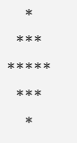
Exercise 5 — Build a Diamond
Requirement
Repeatedly:
Read the diamond size.
Display the diamond.
Read another size.
Stop when -1 is entered.
I interpret size as the maximum number of stars in the middle row.
For:
Size = 5
the standard diamond is:

Slide 138
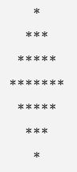
Exercise 5 — Build a Diamond
For:
Size = 7
we get:
For a perfectly symmetric version using this interpretation, it is simplest to use a positive odd size.

Slide 139
Exercise 5 — Build a Diamond
Break It Down — Build It Up
This is exactly the right exercise for incremental development.
Step 1 — First learn to print stars
Python
print("*" * 5)
produces:
*****

Slide 140
Exercise 5 — Build a Diamond
Java
for (int i = 0; i < 5; i++) {
System.out.print("*");
}

Slide 141
Exercise 5 — Build a Diamond
Step 2 — Add spaces
For the first row of a size-5 diamond:
*
We need:
2 spaces + 1 star
For the second row:
***
we need:
1 space + 3 stars
Then:
0 spaces + 5 stars

Slide 142
Exercise 5 — Build a Diamond
Step 3 — Understand the upper half
For size 5:
Row | Spaces | Stars
1 | 2 | 1
2 | 1 | 3
3 | 0 | 5
Stars increase by 2.
Spaces decrease by 1.

Slide 143
Exercise 5 — Build a Diamond
Step 4 — Understand the lower half
Then reverse:
Row | Spaces | Stars
4 | 1 | 3
5 | 2 | 1

Slide 144
Exercise 5 — Build a Diamond
Python
Step 5 — Write a method for one row
def print_row(spaces, stars):
print(
" " * spaces
+ "*" * stars
)

Slide 145
Exercise 5 — Build a Diamond
Step 6 — Create the upper half
middle = size // 2
for row in range(middle + 1):
spaces = middle - row
stars = 2 * row + 1
print_row(
spaces,
stars
)

Slide 146
Step 7 — Create the lower half
for row in range(
middle - 1,
-1,
-1):
spaces = middle - row
stars = 2 * row + 1
print_row(
spaces,
stars
)

Slide 147
Step 8 — Put it inside show_diamond()
def show_diamond(size):
middle = size // 2
for row in range(middle + 1):
spaces = middle - row
stars = 2 * row + 1
print_row(spaces, stars)
for row in range(
middle - 1,
-1,
-1):
spaces = middle - row
stars = 2 * row + 1
print_row(spaces, stars)

Slide 148
Step 9 — Repeat until -1
while True:
size = int(
input("Size = ")
)
if size == -1:
break

Slide 149
Completed Python — Lab5Ex5.py
def print_row(spaces, stars):
print(
" " * spaces
+ "*" * stars
)
def show_diamond(size):
middle = size // 2
# Upper half including middle
for row in range(middle + 1):
spaces = middle - row
stars = 2 * row + 1
print_row(
spaces,
stars
)
# Lower half
for row in range(
middle - 1,
-1,
-1):

Slide 150
spaces = middle - row
stars = 2 * row + 1
print_row(
spaces,
stars
)
def main():
while True:
size = int(
input("Size = ")
)
if size == -1:
break
if size <= 0 or size % 2 == 0:
print(
"Please enter a positive odd size."
)
continue
show_diamond(size)
if __name__ == "__main__":
main()

Slide 151
Java
Step 1 — Create a method to print one row
public static void printRow(
int spaces,
int stars) {
for (
int i = 0;
i < spaces;
i++
) {
System.out.print(" ");
}
for (
int i = 0;
i < stars;
i++
) {
System.out.print("*");
}
System.out.println();
}

Slide 152
Step 2 — Create the diamond method
public static void showDiamond(
int size) {
int middle =
size / 2;
}

Slide 153
Step 3 — Build the upper half
for (
int row = 0;
row <= middle;
row++
) {
int spaces =
middle - row;
int stars =
2 * row + 1;
printRow(
spaces,
stars
);
}

Slide 154
Step 4 — Build the lower half
for (
int row = middle - 1;
row >= 0;
row--
) {
int spaces =
middle - row;
int stars =
2 * row + 1;
printRow(
spaces,
stars
);
}

Slide 155
Step 5 — Repeat until -1
while (true) {
int size =
input.nextInt();
if (size == -1) {
break;
}
showDiamond(size);
}

Slide 156
Completed Java — Lab5Ex5.java
import java.util.Scanner;
public class Lab5Ex5 {
public static void printRow(
int spaces,
int stars) {
for (
int i = 0;
i < spaces;
i++
) {
System.out.print(" ");
}
for (
int i = 0;
i < stars;
i++
) {
System.out.print("*");
}
System.out.println();
}

Slide 157
public static void showDiamond(
int size) {
int middle =
size / 2;
// Upper half including middle
for (
int row = 0;
row <= middle;
row++
) {
int spaces =
middle - row;
int stars =
2 * row + 1;
printRow(
spaces,
stars
);
}
// Lower half
for (
int row = middle - 1;
row >= 0;
row--
) {

Slide 158
int spaces =
middle - row;
int stars =
2 * row + 1;
printRow(
spaces,
stars
);
}
}
public static void main(String[] args) {
Scanner input =
new Scanner(System.in);
while (true) {
System.out.print(
"Size = "
);
int size =
input.nextInt();
if (size == -1) {
break;
}

Slide 159
if (
size <= 0
|| size % 2 == 0
) {
System.out.println(
"Please enter "
+ "a positive odd size."
);
continue;
}
showDiamond(size);
}
input.close();
}
}

Slide 160

Let’s Answer Your Questions
Canvas Inbox – For academic queries.
Email – For formal communication and attachments.
Canvas Discussion – For academic discussions and general queries.
Reminder – Please follow up if you do not receive a response within 3 business days.

Slide 161

Happy Learning and Bright Futures Ahead! Dr. Farshid Keivanian Stay Connected: linkedin.com/in/farshid-keivanian github.com/FarshidKeivanian
Education is the most powerful weapon you can use to change the world. — Nelson Mandela

